Slide 1

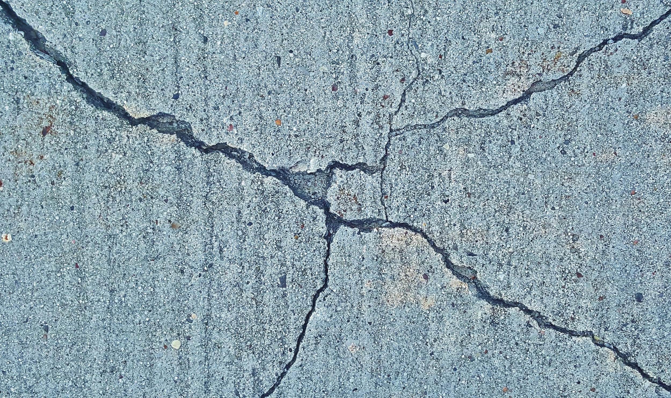
CRACK DETECTION USING A CNN
Mitsis Alexandros Dimopoulos Alexandros Tamvakis Georgios-Emmanouil

Slide 2
A FEW WORDS ABOUT SDNET2018
SDNET2018 is a large, annotated image dataset designed for training and evaluating artificial intelligence algorithms for concrete crack detection. It contains over 56,000 RGB images of cracked and non-cracked concrete bridge decks, walls, and pavements, with crack widths ranging from 0.06 mm to 25 mm.

Slide 3
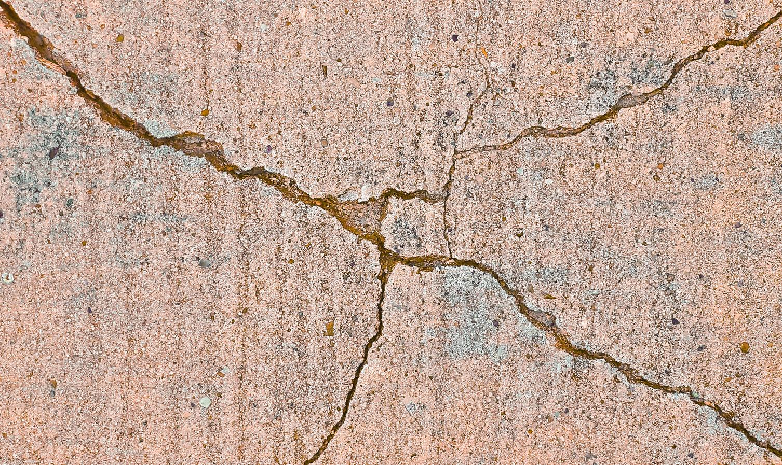
PROJECT OVERVIEW
Raw image acquisition from Bridge Decks, Pavements & Walls
Standardized preprocessing.
Class Imbalance handle.
Csv reproduction.
01
02
Dataloading pipeline
Batch Size of 32 img & shuffle on training.
Shallow CNN model
Transfer learning from Resnet18 model

Slide 4
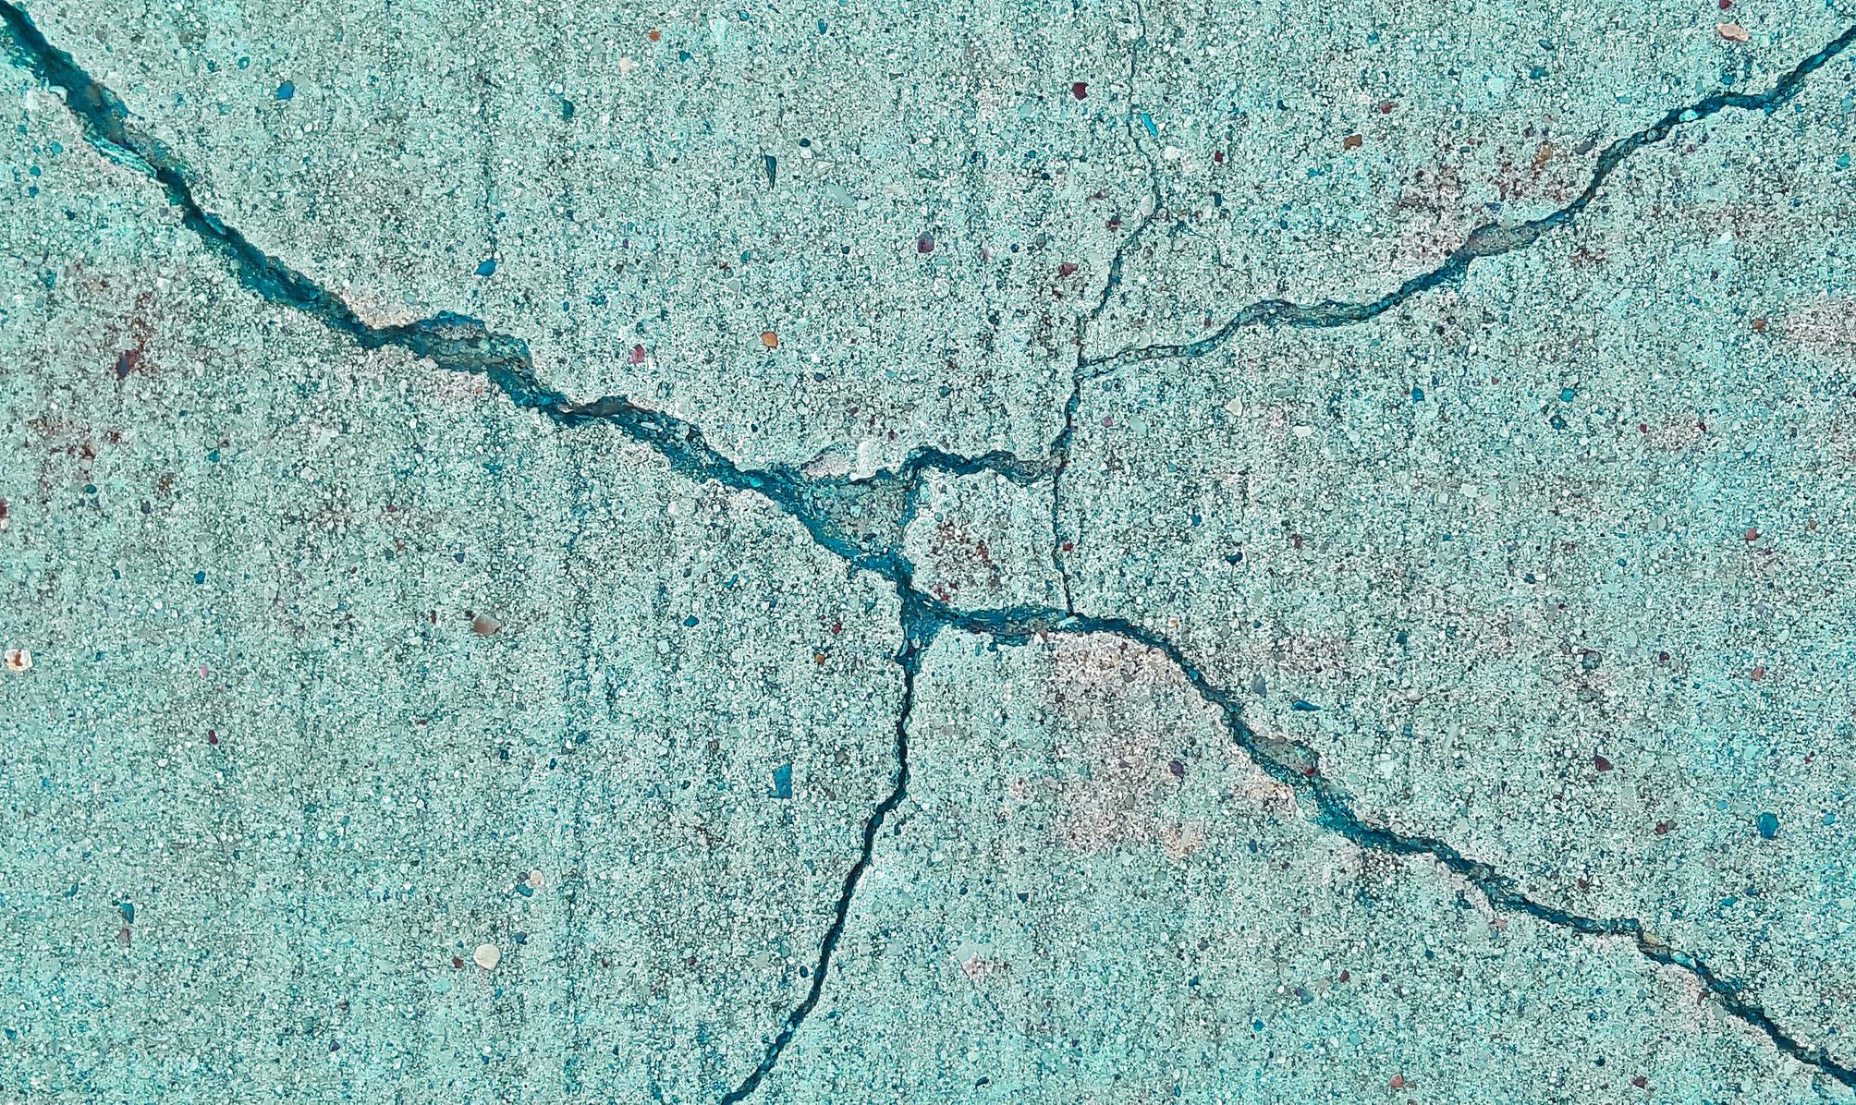
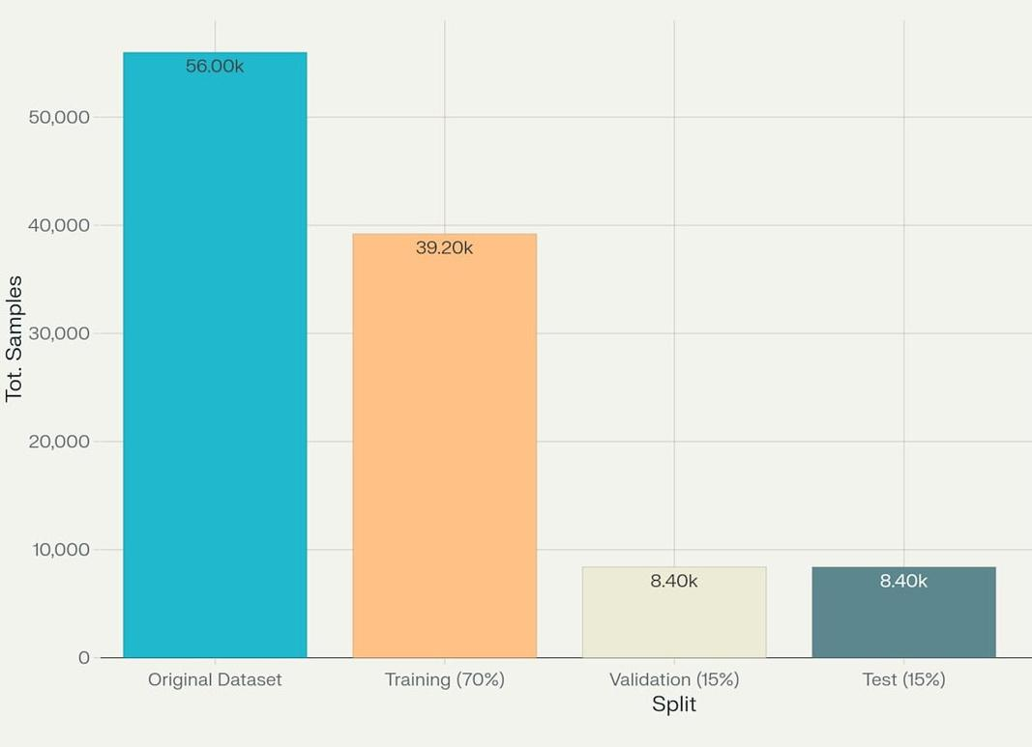
DATA PREPARATION PIPELINE
Dataset organized into superfolders (D, P, W) and subfolders (Cracked/Uncracked)
Binary relabel: Cracked → class 0, Uncracked → class 1
Stratified 70/15/15 split preserving class ratios
Address imbalance: undersample Uncracked & oversample Cracked in training
Persist splits via CSV for reproducibility

Slide 5
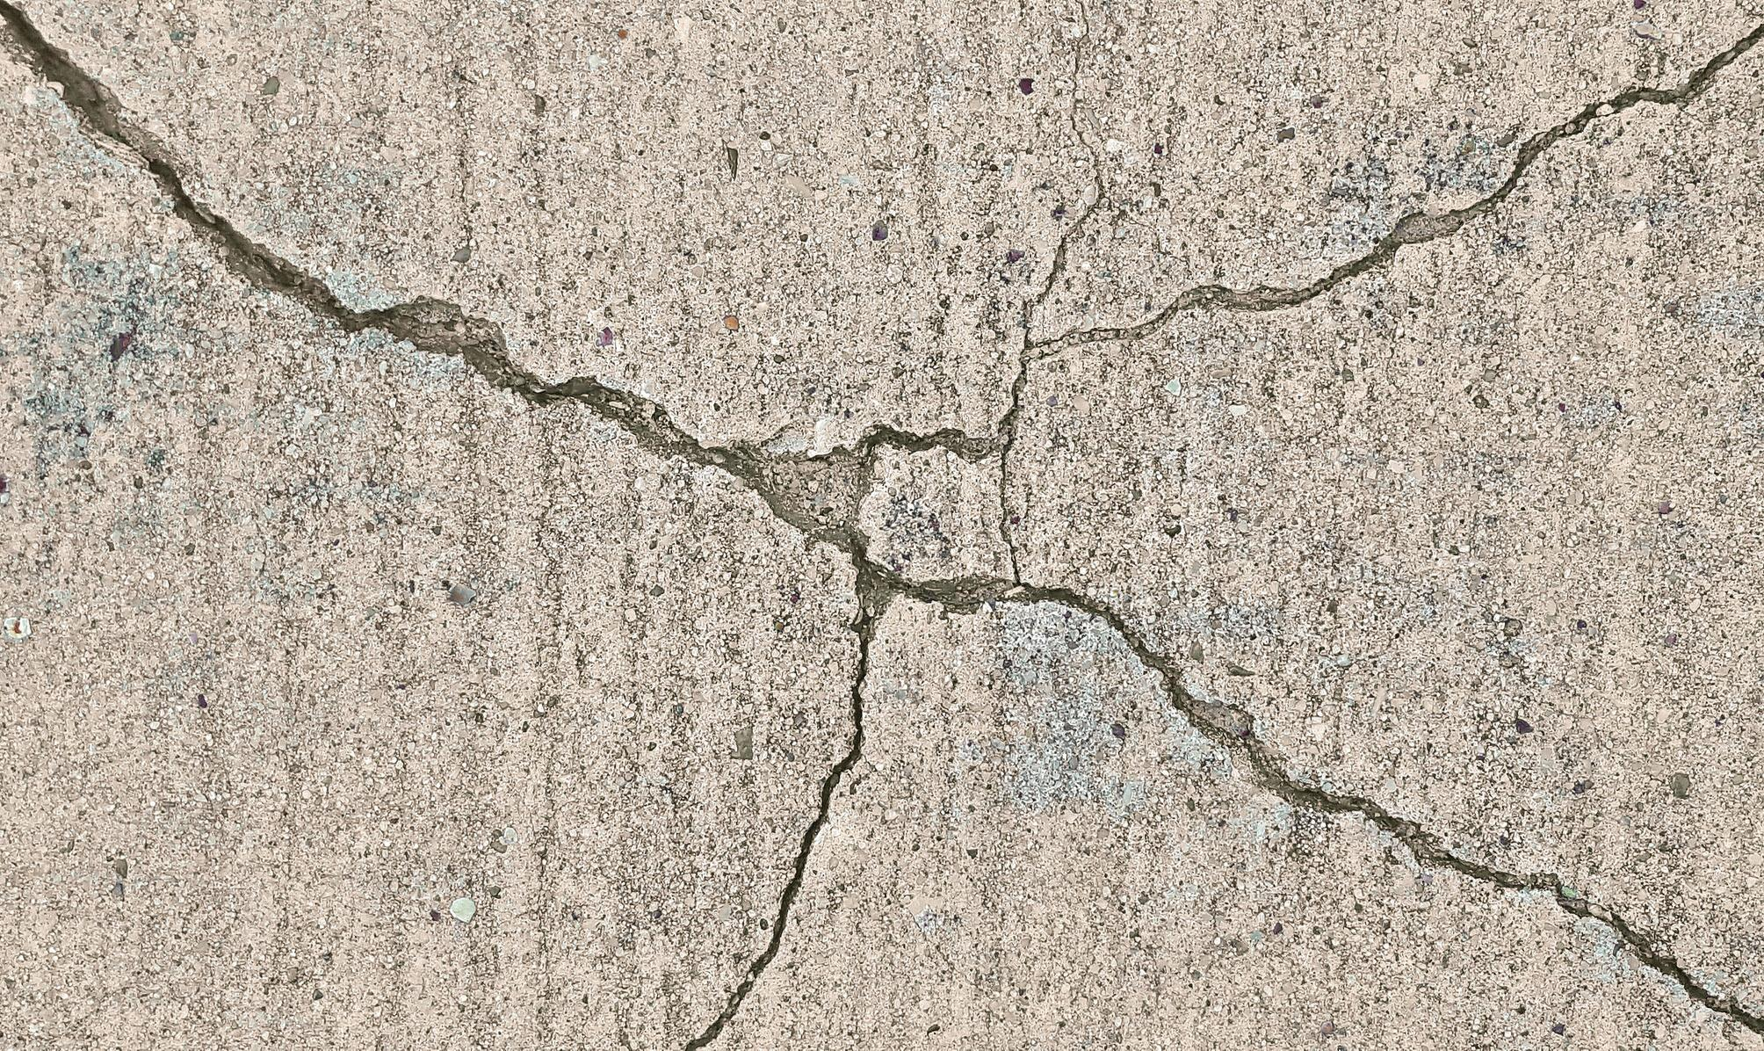
CUSTOM DATASET & DATALOADERS
CustomImageDataset reads CSVs, loads images with PIL
Transform pipeline: Resize to 64×64 from 256x256 → Tensor → Normalize (ImageNet means/stds)
Batch size 32; shuffle training loader only
Prior distribution remains the same for validation & test

Slide 6
MODEL ARCHITECTURE
Convolutional Block (two identical layers)
Conv→BatchNorm→ReLU→MaxPool ×2 (32→64 channels, 3×3 kernels) two identical layers
Output feature map: 16×16×64
Parameters :19584
01
02
Fully Connected Block
Flatten → Linear(16 384→24) → ReLU
Dropout(0.5) → Linear(24→1) → Sigmoid
Total parameters: ~413 K

Slide 7
LOSS FUNCTION & EVALUATION METRICS
Focal Loss (α=0.75, γ=2.0) to adress the imbalance focusing on the on challenging missclassified samples.
Primary metrics:
Recall (sensitivity to detect cracks)
Precision (minimize false alarms)
F1-score (balance between precision & recall)
AUC-ROC (class separation ability)
Accuracy computed but de-emphasized due to imbalance

Slide 8

EPOCH ANALYSIS & RESULTS
Epochs 0–2: underfitting, only majority class predicted.
Epochs 3–10: recall →13%, F1 →0.24; high precision maintained; AUC→0.67
Epochs 11-15 : recall →28%, F1 →0.43, AUC →69%
Epochs 21 Highest recall →41%
Trainingphase: forward→FocalLoss→backward→Adam step
Validation phase: compute loss & metrics (no gradient)
Checkpointing: save best F1 model
Early stopping: stop if F1 not improved for 5 epochs

Slide 9

TRANSFER LEARNING
Early ResNet18 layers are frozen to retain general image features, while later layers and a custom classifier are fine-tuned.
Fine-tuning and careful hyperparameter selection are critical for adapting the model to domain-specific patterns and maximizing recall.
Classified a cracked image correctly with confidence 0.49, further tuning is considered necessary.

Slide 10
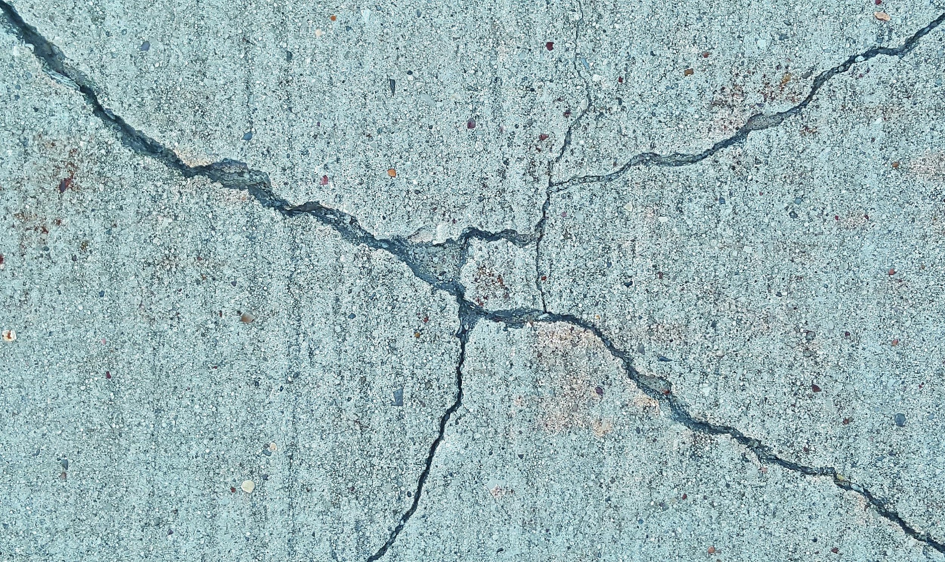
THANK YOU

